Slide 1



Heart Disease Detection Using ECG Waves
Shivam Thakkar
Dweep Vira
Usaid Khan
(Final Year Engineering)
Academic Year 2023-24

Slide 2
Outline of Presentation
Introduction
Summary / Finding of Literature Survey
System Design & Architecture
Proposed Methodology( Algorithm / Flowchart etc)
Video & Audio demonstration of Running Project(5Mins)
Results
Conclusion
References

Slide 3
Introduction
Heart disease remains one of the leading causes of mortality globally, making early detection and timely intervention of utmost importance. Electrocardiogram (ECG) data, which measures the electrical activity of the heart, holds the potential to revolutionize the detection and diagnosis of heart conditions. With the continuous advancements in technology and the advent of smartwatches equipped with ECG sensors, it is now possible to monitor the heart's electrical signals conveniently and unobtrusively.
This project aims to harness the power of ECG data sent from smartwatches to develop an efficient and accurate heart disease detection system. By analyzing the ECG signals collected over extended periods from a diverse population of users, we intend to create a robust algorithm capable of identifying various heart conditions, such as arrhythmias, atrial fibrillation, and other abnormalities.

Slide 4
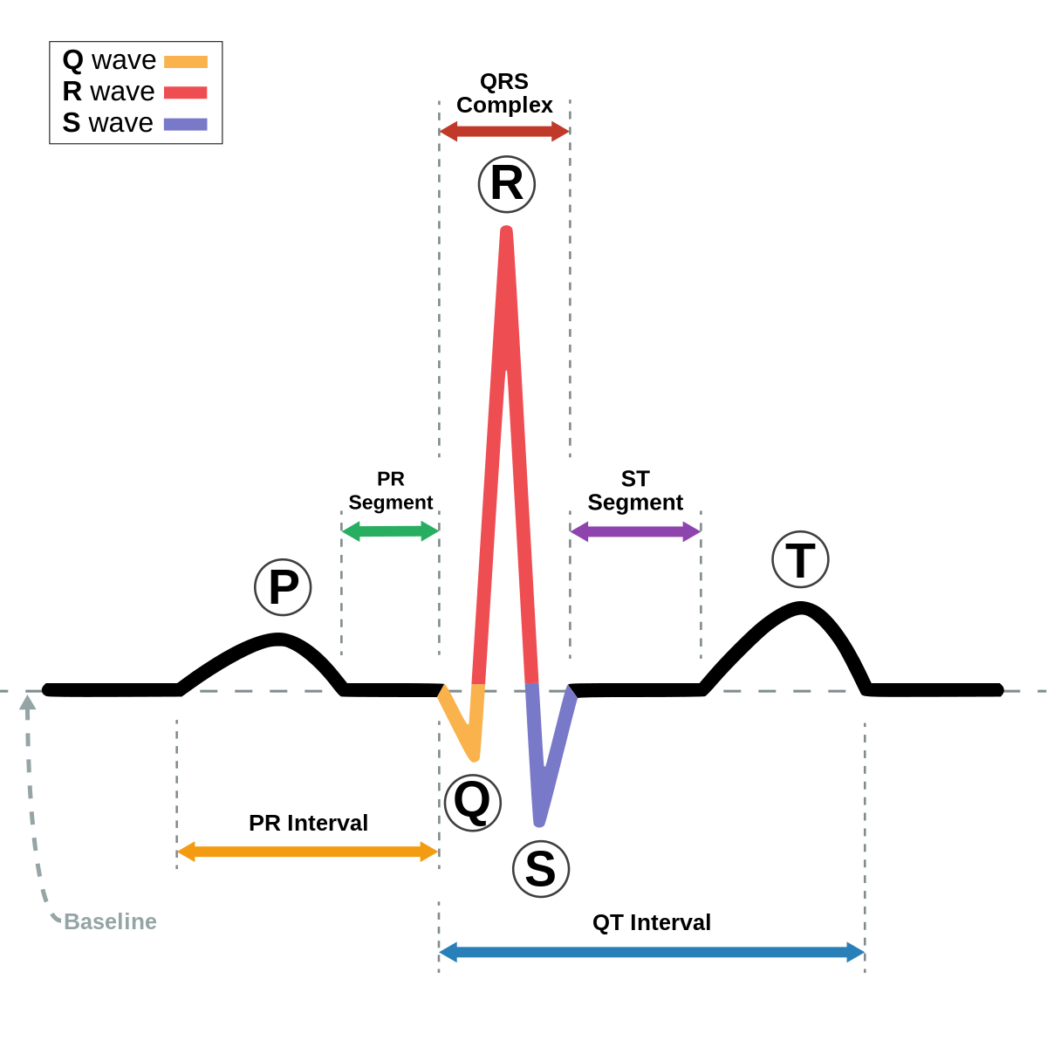
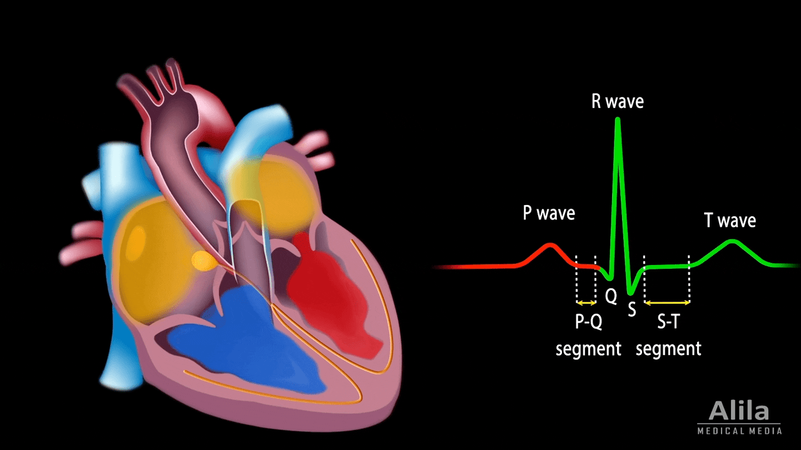
ECG Waves
P Wave: Represents atrial depolarization and electrical activation of the atria.
PR Interval: Denotes the time between the P wave and the QRS complex, allowing for ventricular filling.
QRS Complex: Signifies ventricular depolarization and activation leading to ventricular contraction.
ST Segment: Follows the QRS complex and can indicate cardiac ischemia or injury.
T Wave: Represents ventricular repolarization and readiness for the next contraction.
QT Interval: Measures the time for ventricular depolarization and repolarization, with prolonged intervals associated with ventricular arrhythmia risk.

Slide 5
Problem Statement
The problem addressed in this study is the detection and prediction of heart disease using machine learning algorithms.
The traditional methods of heart disease diagnosis involve clinical assessments, medical history analysis, and diagnostic tests. While these approaches are valuable, they may have limitations in terms of accuracy and efficiency, especially in detecting subtle patterns and risk factors that might lead to heart disease.
Machine learning algorithms offer the potential to overcome these limitations by analyzing large datasets containing patient information, including vital signs, medical records, lifestyle factors, and test results. By learning from historical data, ML algorithms can develop predictive models that identify individuals at high risk of developing heart disease.

Slide 6
Finding of Literature Survey
In this paper [1] we learned that Electrocardiogram (ECG) signals represent the electrical activity of the human hearts and consist of several waveforms (P, QRS, and T). The duration and shape of each waveform and the distances between different peaks are used to diagnose heart diseases. In this work, to better analyze ECG signals, a new algorithm that exploits two-event related moving-averages (TERMA) and fractional-Fourier-transform (FrFT) algorithms is proposed. The TERMA algorithm specifies certain areas of interest to locate desired peak, while the FrFT rotates ECG signals in the time-frequency plane to manifest the locations of various peaks. The proposed algorithm’s performance outperforms state-of-the-art algorithms.
In the papers [2] &[3] we explored the use of various supervised ML algorithms for heart disease detection. These algorithms include Artificial Neural Network (ANN), Decision Tree (DT), Random Forest (RF), Support Vector Machine (SVM), Naïve Bayes (NB), and k-Nearest Neighbor (k-NN) algorithm. Each of these algorithms possesses unique strengths and capabilities, making them suitable candidates for heart disease prediction tasks. We aim to compare and evaluate the performances of these algorithms to determine their efficiency in identifying individuals at risk of heart disease.

Slide 7
Finding of Literature Survey
In [4]: SVM and CNN models are compared for classifying ECG signals with an average accuracy of 87.2% using AlexNet, demonstrating the superiority of deep learning over traditional SVM.
While [5] proposes using Wavelet Transform and machine learning algorithms, achieving the highest accuracy of 99.4% with linear SVM for classifying cardiac ventricular arrhythmias from ECG signals.
The main focus of [6] is using Convolutional Neural Networks (CNN) to classify ECG signals with a total of 17 classes and achieves promising results in terms of accuracy.
Based on the provided information, [5] appears to be the best due to its higher accuracy and effective use of machine learning techniques like Wavelet Transform and SVM. To further improve the classification results, a potential new approach could be combining the deep learning architecture (CNN) from [6] with the feature extraction methods (Wavelet Transform) and SVM classifier from [5]. This hybrid approach may enhance feature representation and classification performance for ECG signal analysis.

Slide 8
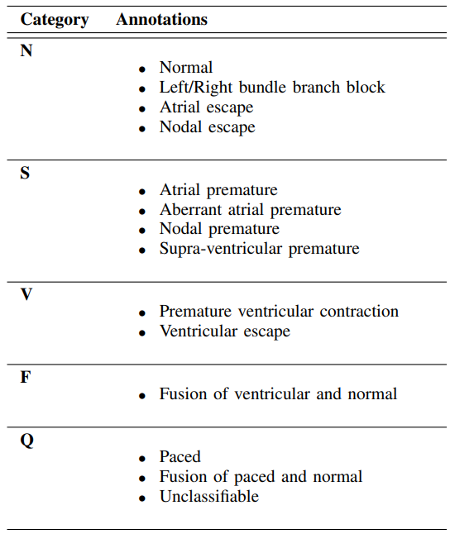
Finding of Literature Survey
Final Classes after Classification from [10]

Slide 9

SUMMARY OF OUR FINDINGS
We have discussed several papers related to the analysis and classification of Electrocardiogram (ECG) signals for heart disease detection. In [1], a new algorithm combining two-event related moving-averages and fractional-Fourier-transform is proposed, outperforming existing methods in diagnosing heart diseases based on ECG signals. [2] and [3] explore supervised ML algorithms (ANN, DT, RF, SVM, NB, k-NN) for heart disease prediction, while [4] compares SVM and CNN models for ECG signal classification, showing the superiority of deep learning. [5] achieves the highest accuracy (99.4%) using Wavelet Transform and SVM for cardiac ventricular arrhythmias classification, and [6] focuses on using CNNs with promising results.
Our project aims to enhance ECG signal analysis by combining the feature extraction techniques (Wavelet Transform) and SVM classifier from [5] with the deep learning architecture (CNN) from [6], seeking improved feature representation and classification performance for heart disease detection.

Slide 10
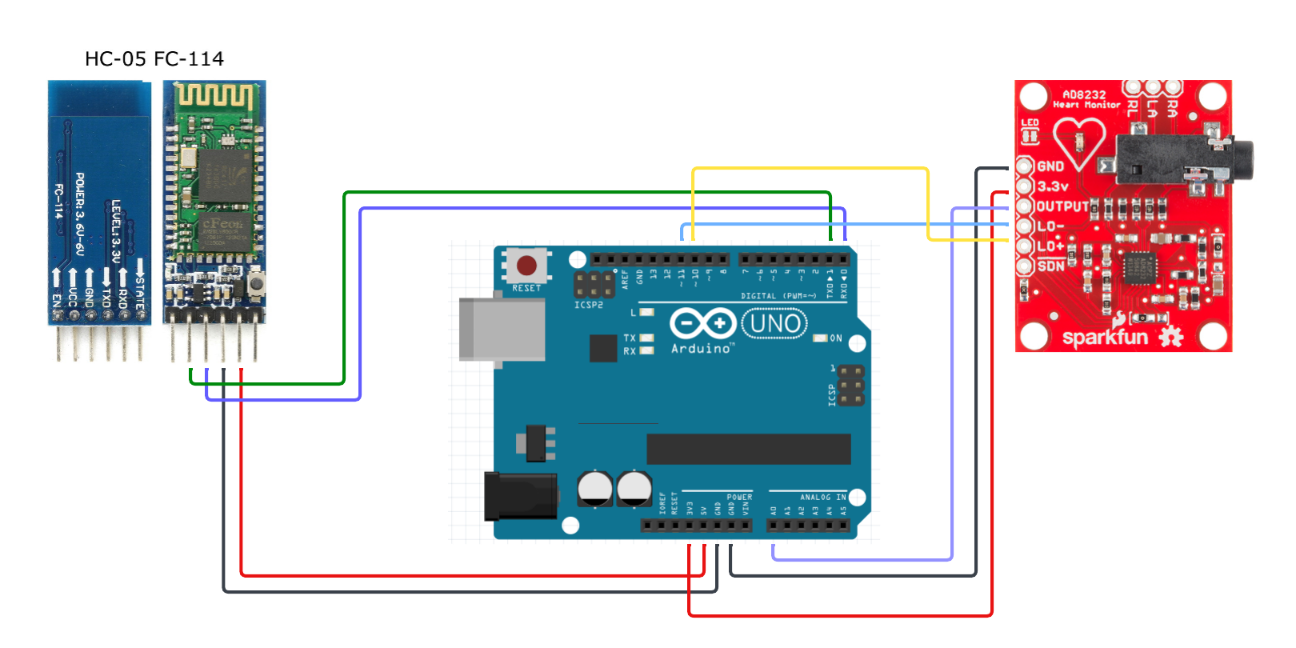
System Design & Architecture (Circuit Diagram)
ECG Sensor

Slide 11
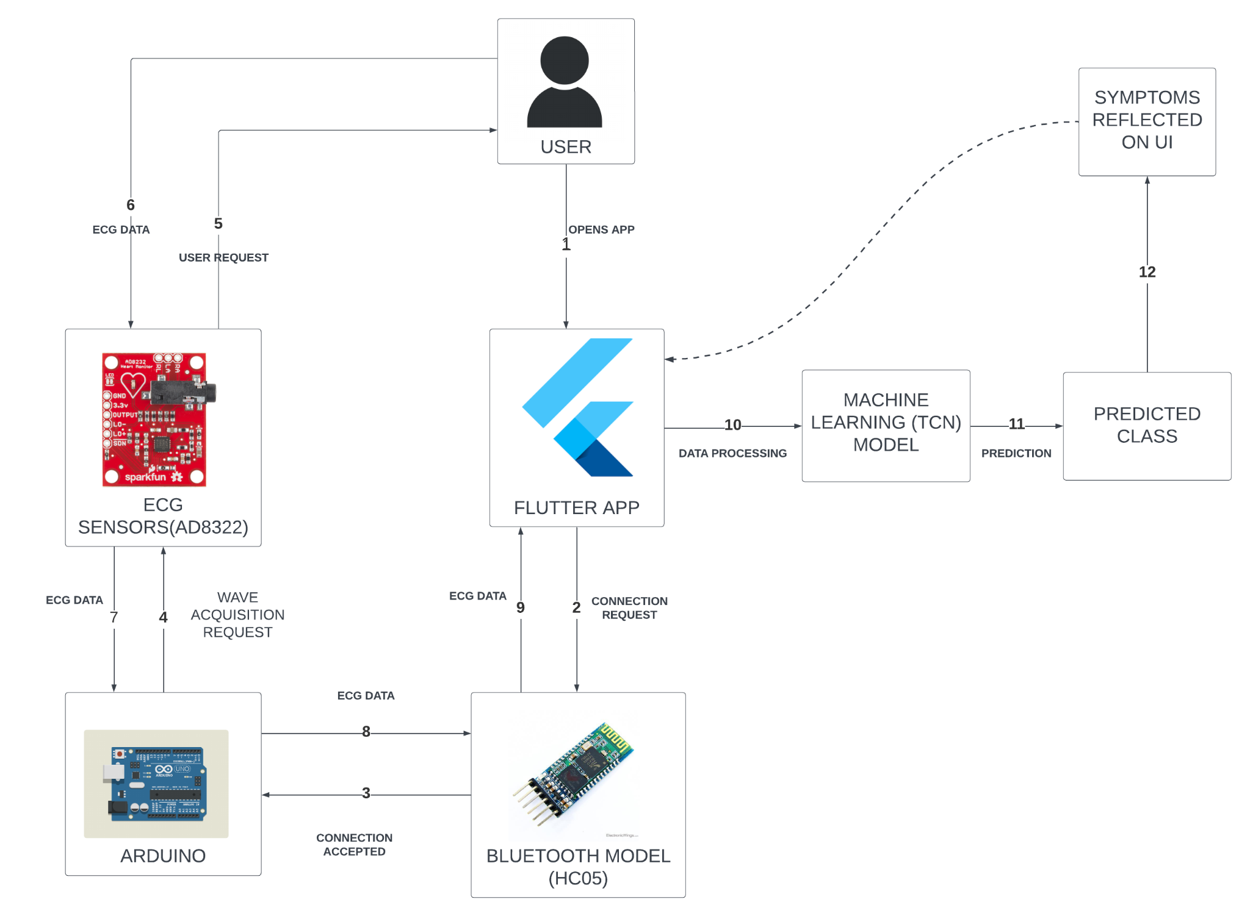
Proposed Methodology (Flowchart)

Slide 12
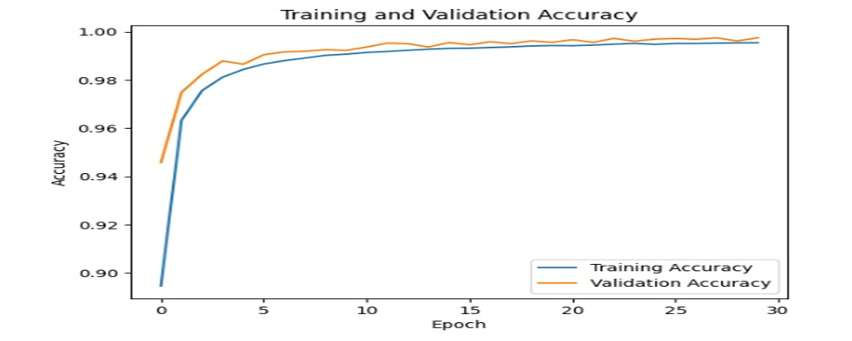
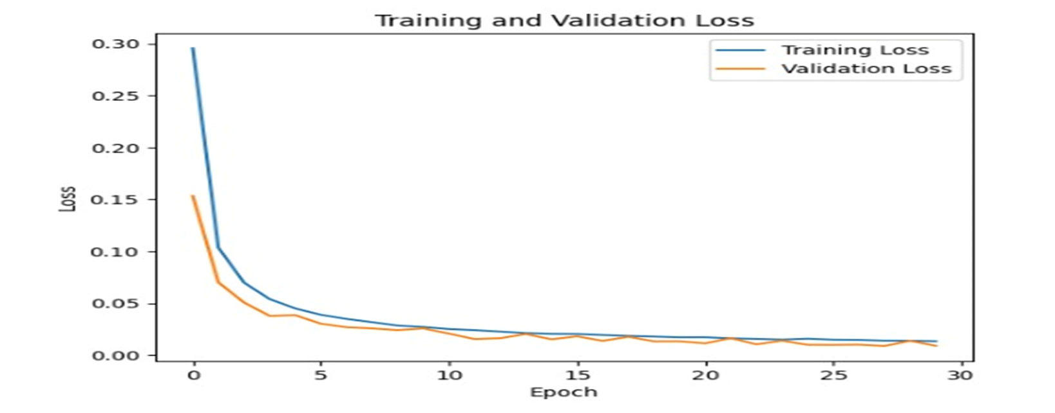
Results

Slide 13
This project underscores the growing importance of ECG data for precise cardiovascular disease diagnosis. Notable advancements in signal processing, machine learning, and data acquisition enhance diagnostic efficiency. ECG signals, being non-invasive, remain fundamental for detecting cardiac abnormalities. Machine learning models, including CNNs and SVMs, automate the identification of abnormal cardiac patterns. Collaborative efforts and affordable hardware improve healthcare accessibility. Challenges include model scalability, generalizability, interpretability, and maintaining data security and patient privacy during clinical integration.
Conclusion

Slide 14
REFERENCES
[1] Aziz, Saira & Ahmed, Sajid & Alouini, Mohamed-Slim. (2021). ECG-based machine-learning algorithms for heartbeat classification. Scientific Reports. 11. 18738. 10.1038/s41598-021-97118-5.
https://www.researchgate.net/publication/354725060_ECG-based_machine-learning_algorithms_for_heartbeat_classification
[2] R. Aggarwal and S. Kumar, "MLPPCA: Heart Disease Detection using Machine learning," 2022 Seventh International Conference on Parallel, Distributed and Grid Computing (PDGC), Solan, Himachal Pradesh, India, 2022, pp. 457-461, doi: 10.1109/PDGC56933.2022.10053266.
https://ieeexplore.ieee.org/document/10053266
[3] M. S. Raja, M. Anurag, C. P. Reddy and N. R. Sirisala, "Machine Learning Based Heart Disease Prediction System," 2021 International Conference on Computer Communication and Informatics (ICCCI), Coimbatore, India, 2021, pp. 1-5, doi: 10.1109/ICCCI50826.2021.9402653.
https://ieeexplore.ieee.org/document/9402653
[4] S. S. Tippannavar, R. Harshith, R. Shashidhar, S. C. Sweekar and S. Jain, "ECG based Heart Disease Classification and Validation using 2D CNN," 2022 5th International Conference on Contemporary Computing and Informatics (IC3I), Uttar Pradesh, India, 2022, pp. 1182-1186, doi: 10.1109/IC3I56241.2022.10073094.
https://ieeexplore.ieee.org/document/10073094
[5 ]H. A. Poonja, M. Soleman Ali Shah, M. A. Shirazi and R. Uddin, "Evaluation of ECG based Recognition of Cardiac Abnormalities using Machine Learning and Deep Learning," 2021 International Conference on Robotics and Automation in Industry (ICRAI), Rawalpindi, Pakistan, 2021, pp. 1-4, doi: 10.1109/ICRAI54018.2021.9651457.
https://ieeexplore.ieee.org/document/9651457
[6] V. G. Rajendran, S. Jayalalitha, M. Thalaimalaichamy and T. N. Raj, "Classification of heart disease from ECG signals using Machine Learning," 2021 International Conference on Recent Trends on Electronics, Information, Communication & Technology (RTEICT), Bangalore, India, 2021, pp. 606-609, doi: 10.1109/RTEICT52294.2021.9573659.
https://ieeexplore.ieee.org/document/9573659
[7] Alarsan, F.I., Younes, M. Analysis and classification of heart diseases using heartbeat features and machine learning algorithms. J Big Data 6, 81 (2019). https://doi.org/10.1186/s40537-019-0244-x
[8] Alarsan, F.I., Younes, M. Analysis and classification of heart diseases using heartbeat features and machine learning algorithms. J Big Data 6, 81 (2019). https://doi.org/10.1186/s40537-019-0244-x
[9] Alarsan, F.I., Younes, M. Analysis and classification of heart diseases using heartbeat features and machine learning algorithms. J Big Data 6, 81 (2019). https://doi.org/10.1186/s40537-019-0244-x

Slide 15
Thank You…!

